Slide 1
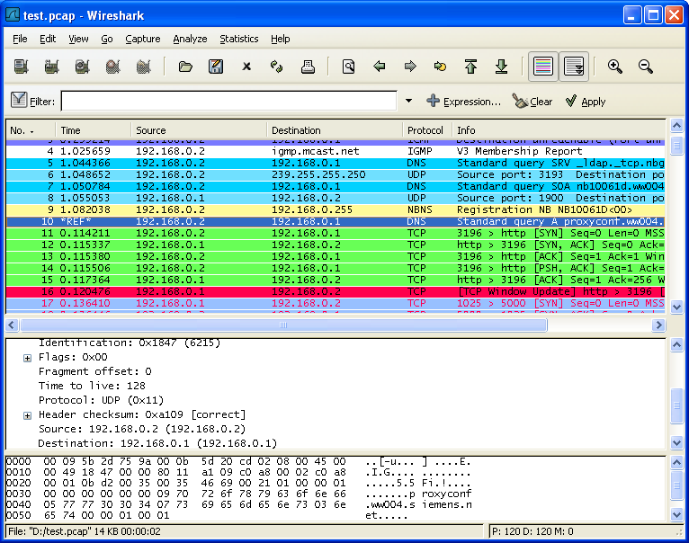

Wireshark

Slide 2
Introduction
Wireshark is a free and open-source packet analyzer.
It is used for network troubleshooting, analysis, software and communications protocol development, and education.
Originally named Ethereal, the project was renamed Wireshark in May 2006 due to trademark issues.
Wireshark is very similar to tcpdump, but has a graphical front-end and integrated sorting and filtering options.
When put into promiscuous mode, Wireshark can all the traffic visible on that interface including unicast traffic not sent to that network interface controller's MAC address.

Slide 3
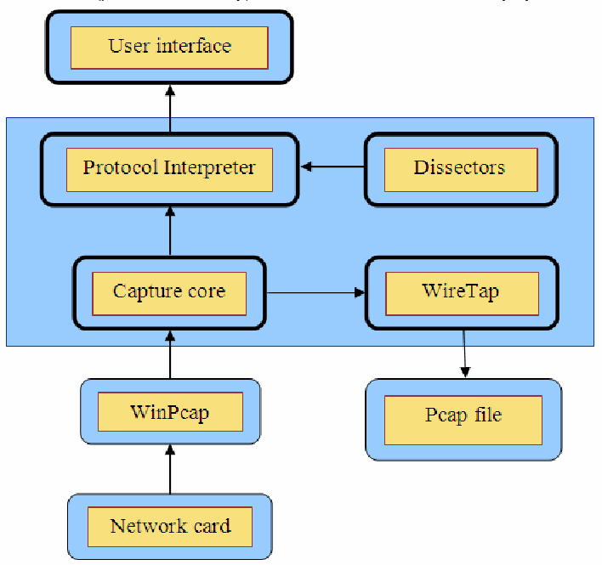
WinPcap vs. Wireshark
WinPcap, Npcap, libpcap are the libraries to capture raw packets.
Wireshark, TShark, tcpdump are the programs which interact with users, and parse/display packets accordingly.
Source: https://www.researchgate.net/figure/Wireshark-Architecture_fig9_267421729

Slide 4
Capture Filter of libpcap
icmp - Capture ICMP Echo Request/Reply
udp port 5060
udp port 5060 or tcp port 1060
portrange 5060-5062
dst port 1060
host 192.168.1.10
src host 192.168.1.10
net 163.22.17.0/24

Slide 5
Display Filter of Wireshark
Display filter is not a capture filter
tcp.port == 22 or icmp
  Show only SMTP and ICMP
ip.src==192.168.0.0/16 and ip.dst==192.168.0.0/16
  Show only traffic in the LAN (192.168.x.x)
tcp.window_size == 0 && tcp.flags.reset != 1
  TCP buffer full -- Source is instructing Destination to stop sending data
udp[8:3]==81:60:03
  Match packets containing the (arbitrary) 3-byte sequence 0x81, 0x60, 0x03 at the beginning of the UDP payload, skipping the 8-byte UDP header.
eth.addr[0:3]==00:06:5B
  filter on the vendor identifier part (OUI) of the MAC address

Slide 6
Display Filter (cont.)
udp contains 81:60:03
  Match packets that contains the 3-byte sequence 0x81, 0x60, 0x03 anywhere in the UDP header or payload
sip.To contains "a1762"
  Match packets where SIP To-header contains the string "a1762" anywhere in the header
ip.src == 10.43.54.65 or ip.dst == 10.43.54.65
  Equivalent to ip.addr == 10.43.54.65
ip.src != xxx.xxx.xxx.xxx && ip.dst != xxx.xxx.xxx.xxx && sip
  Filter by a protocol ( e.g. SIP ) and filter out unwanted IPs
http.request.uri matches "gl=se$"
  Match HTTP requests where the last characters in the uri are the characters "gl=se"

Slide 7
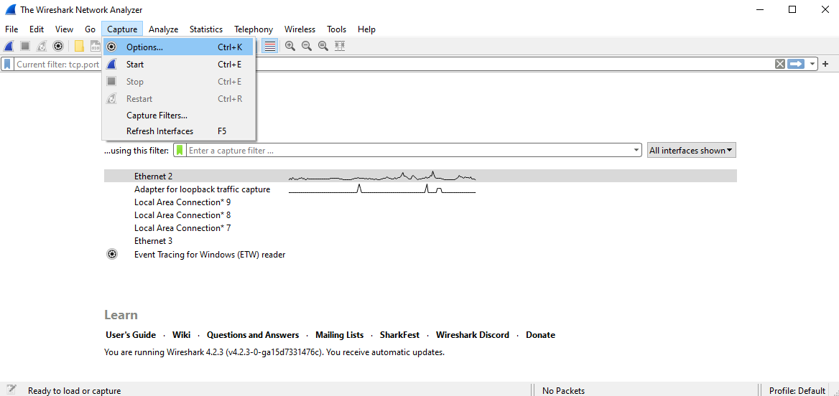
Capture - Options

Slide 8
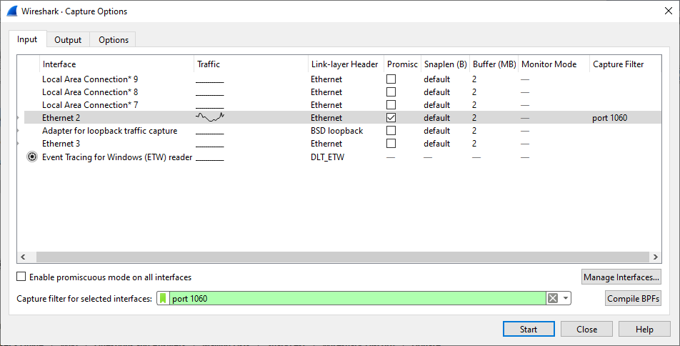
Capture filter

Slide 9
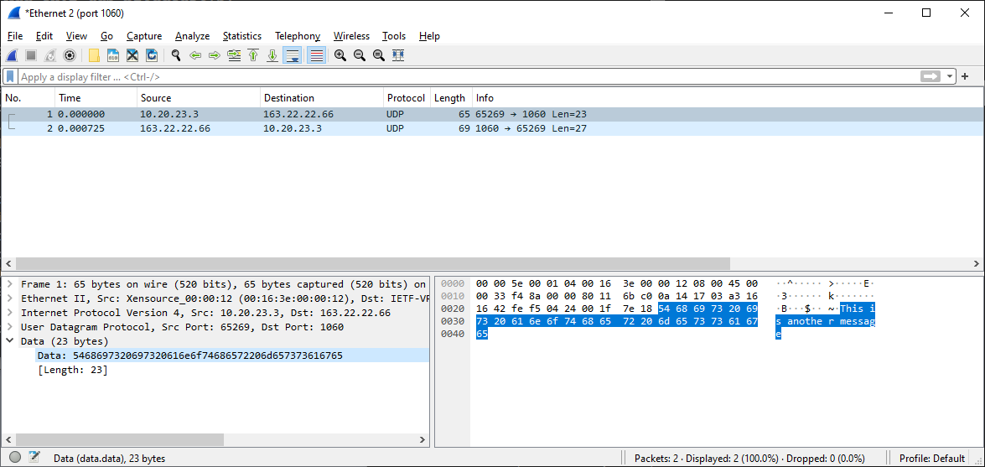
Start capturing

Slide 10
Network Header Steganography

Slide 11
SELECT FROM
Steganalysis Algorithm
Extract
Header Fields
.pcap file
Chi-Square Test
If you only want to extract a nibble, you may (ip[12] & 0xf0) >> 4
4 bits or 8 bits?
SELECT ip[8:3] FROM test.pcap INTO car.bmp;
SELECT ChiSquaire(ip[8:3], 25) FROM test.pcap;
SELECT ChiSquare(ip[8:3], 25), RS(ip[8:3) FROM test.pcap;
RS Test
Other Statistical Measures
(Multi-Probe)

Slide 12
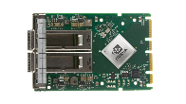
INJECT stream/file WITH method ONTO pcap;
Internet
Secret Message
Covert Message
Steganography Algorithm
Stego Message
(.pcap file)
Sending Packets with Scapy
Least Significant Bit
Spread Spectrum
4096 bytes injected into 65536 bytes (256 packets)
IPv6 Extension Header

Slide 13
Grouping
讀寫組
  109321021 吳侑珉
  110321011 蘇翊荃
  110321053 陳品妤
  110321054 陳姿綾
檢測組 Steganalysis (Chi-Square, RS)
  109321011 劉昱萬
  109321017 林大智
  109321053 繆亭霄
隱寫組 Steganography (LSB
  109321062 劉冠伶
  112321507 梁宇騰
  112321528 沈家正
文法組
  110321026 陳嘉璐
  110321068 陳姿澖

Slide 14
檢測組 Steganalysis (Chi-Square, RS)
SELECT ChiSquare(ip[8:3]) FROM a.pcap;
  Returns a Chi-Square Value
double ChiSquare(char* stream, int size, int nmemb)
double RS(char*)

Slide 15
隱寫組 Steganography (LSB, IPv6_EH)
INJECT secret.txt WITH lsb ONTO test.pcap;
  4096 bytes injected into 65536 bytes (256 packets)
int* lsb(secret_filename, covert_filename, nBit, nStart, nStep)
int* eh(secret_filename, covert_filename

Slide 16
讀寫組
For Steganalysis
  int read(infilename, proto, start, num, *bitstream, int* size)
    proto: specify the proto header
  int write(outfilename, *bitstream, size)
For Steganography
  int read(covert_filename, packet*)
    malloc
  rename(oldname, newname)
  write(packet*, size_t size, char* filename)
    free

