Slide 1
Named-Data Networking 命名資料網路
Week 01

Slide 2
The Internet
Current Internet
IETF
APNIC
Internet Applications
File retrieval
Interactive web browsing
Video streaming
Real-time audio/video/chat
Future Internet

Slide 3
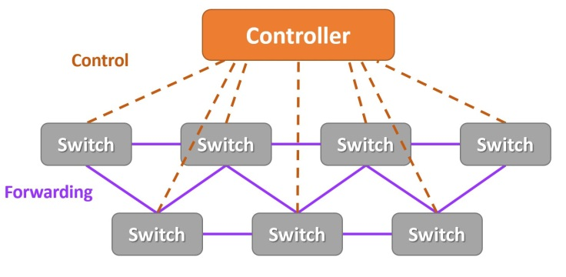
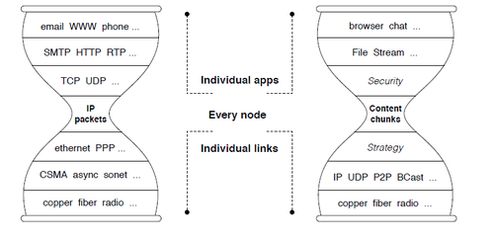
Future Internet Architecture
IP Version 6
Software-Defined Networking
Information-Centric Networking
2a03:2880:f126:83:face:b00c:0:25de
NSF Future Internet Architecture Project

Slide 4
Thin Waist

Slide 5
What Distinguishes NDN?
Authenticity
Multicast
Receiver-driven
Content Stores
Designate data by name instead of IP addresses

Slide 6
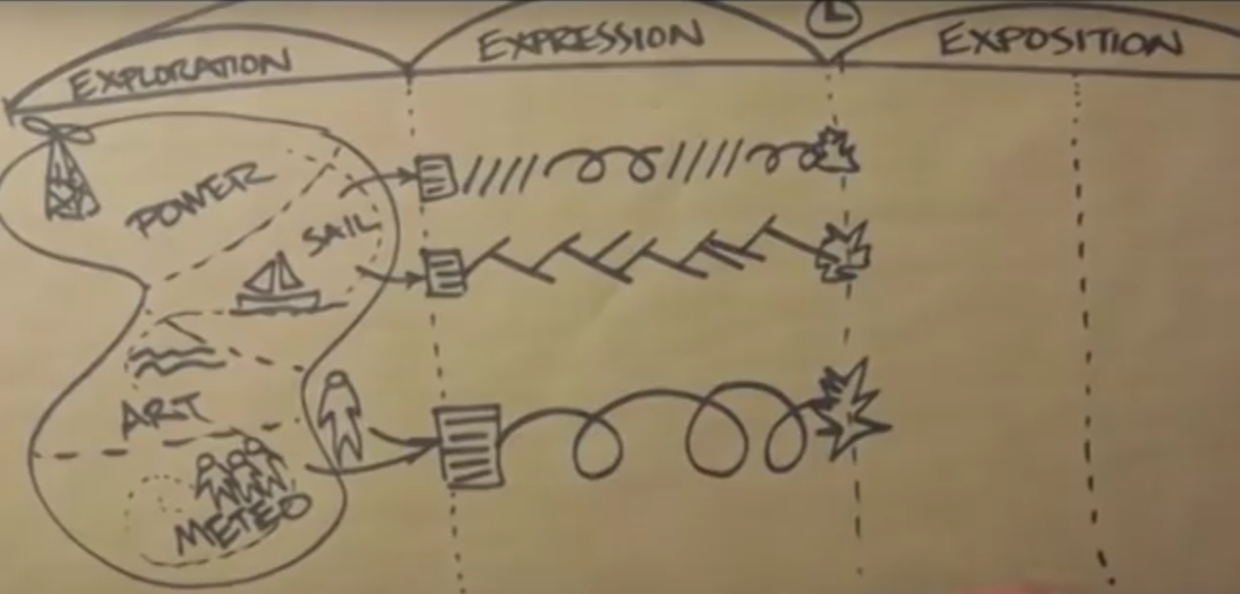
Engagement-based Learning
[TED] 參與式學習

Slide 7
TAs
NDN - Jia-Wei
Python Scraping - Crystal
Python 程式設計 - X, X, X
CS101 - Jia-Wei, X
CCNA - Ken

