Slide 1
Open vSwitch
Name：李仲哲
Student ID：103321508
Advisor：吳坤熹老師

Slide 2
Outline
Developing history
Brief Introduction
Installing Open vSwitch
Basic Operations
Advanced Features
Reference

Slide 3
Developing history
Virtual Switch - Nexus 1000V
VMware - vCenter
Nicira Networks - Open vSwitch
June, 2009 release version 0.90.4
The most recent is 2.3.1
Citrix, KVM, VirtualBox

Slide 4
Brief Introduction
Open source technology and followed Apache 2.0 license
Enhance the efficiency of packet processing
State Database
Support features
OpenFlow Protocol; Spanning Tree Protocol(STP)
Bidirectional Forwarding Detection(BFD)
Per VM interface traffic policing
tunneling protocols
Quality of Service(QoS)

Slide 5
Installing Open vSwitch
Step1：Install packages
Step2：Get the file and decompress it

Slide 6
Modify the file
Generate the rpm file

Slide 7
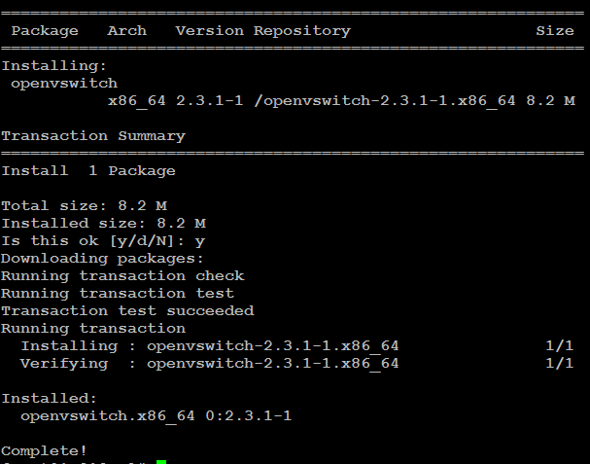
Install the rpm package

Slide 8
Before you start the service, need to solve a problem
Start OpenvSwitch
/etc/init.d/openvswitch start

Slide 9
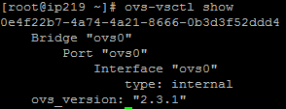
Basic Operations
Check the command-line tools are ready
ovs-vsctl -V
See the information
ovs-vsctl show

Slide 10
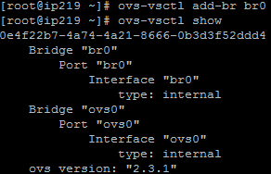
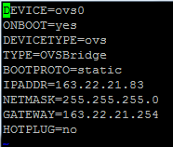
Adding bridge
ovs-vsctl add-br ovs0
vi /etc/sysconfig/network-scripts/ifcfg-ovs0

Slide 11
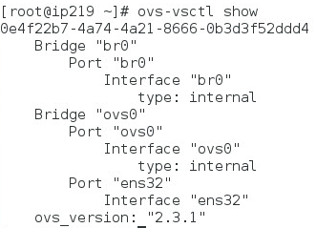
Adding vports
ovs-vsctl add-port br0 eth1
Other related operations
ovs-vsctl list-br
ovs-vsctl list-ports ovs0
ovs-vsctl port-to-br ens32

Slide 12
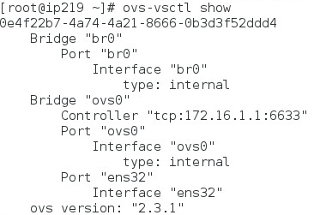
Advanced Features
Connecting to controller
ovs-vsctl set-controller ovs0 tcp:172.16.1.1:6633

Slide 13
vSwitch supports version
ovs-vsctl set bridge ovs0 protocol=OpenFlow10,OpenFlow12,OpenFlow13
ovs-ofctl show ovs0
ovs-ofctl dump-ports ovs0
ovs-ofctl dump-flows ovs0
ovs-ofctl del-flows ovs0
Configuring switch module
ovs-dpctl show
ovs-dpctl dump-flows

Slide 14
Reference
http://openvswitch.org/
https://n40lab.wordpress.com/2015/01/25/centos-7-installing-openvswitch-2-3-1-lts/
http://adaam-tw.blogspot.tw/2012/10/open-vswitch.html
http://rickchen918.blogspot.tw/2013/09/open-vswitch.html
http://www.netadmin.com.tw/article_content.aspx?sn=1107140004

