Slide 1
Indigo Virtual Switch(IVS)
Speaker：Nillson

Slide 2
HOWTO
功能簡介
發展沿革
安裝說明
基本操作
進階功能
參考文獻

Slide 3
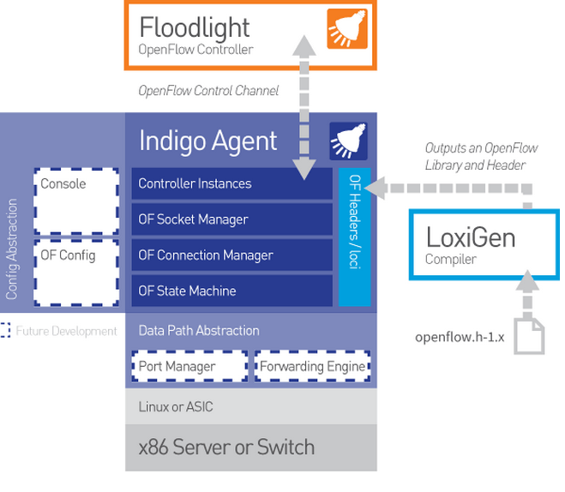
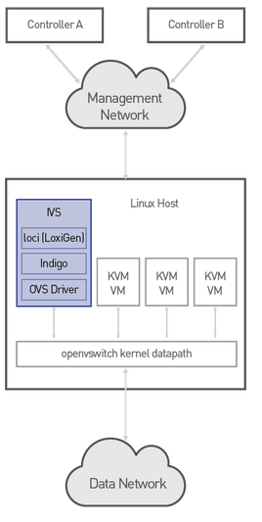
功能簡介

Slide 4
發展沿革

Slide 5
發展沿革
Java Jython
Link Layer Discovery Protocol (LLDP)

Slide 6
安裝說明
Install required dependencies
Clone the IVS repository
Compile IVS
Usege

Slide 7
安裝說明
1.Install required dependencies：
環境：CentOS 7 #sudo yum groupinstall 'Development Tools'
#sudo yum install libnl3-devel libcap-devel libnl3 library for dealing with netlink sockets libcap-dev Contains the necessary support for building applications that use capabilities.

Slide 8
安裝說明
2.Clone the IVS repository：
#git clone --recurse-submodules https://github.com/floodlight/ivs.git reference
git clone git://github.com/floodlight/ivs.git
Cloning into 'floodlight'...
fatal: unable to connect to github.com:
github.com : Temporary failure in name resolution
#git config --global http.proxy %HTTP_PROXY%
reference

Slide 9
安裝說明
#cd ivs && git submodule update --recursive –init
#git submodule sync
#git submodule update –init
reference

Slide 10
安裝說明
3.Compile IVS：
#cd ivs # make ivs 和 ivs-ctl 的執行檔在以下目錄(以下步驟已在/ivs目錄下)： targets/ivs/build/gcc-local/bin/ivs targets/ivs-ctl/build/gcc-local/bin/ivs-ctl # sudo cp targets/ivs/build/gcc-local/bin/ivs /usr/sbin
# sudo cp targets/ivs-ctl/build/gcc-local/bin/ivs-ctl /usr/sbin
reference

Slide 11
安裝說明
4.Usege：
#modprobe openvswitch
Success
Failure

Slide 12
基本操作
ivs [OPTION] ...
-v, --verbose Verbose logging
-t, --trace Very verbose logging
-c, --controller=IP:PORT Connect to a controller at startup
-L host:port Add a listening connection.
-i, --interface=INTERFACE Attach a network interface at startup
--dpid=DPID Set datapath ID (default autogenerated)
--syslog Log to syslog instead of stderr
-h, --help Display this help message and exit
--version Display version information and exit

Slide 13
基本操作
ivs-ctl
-h, --help Display this help message and exit add-port INTERFACE Add a port to the datapath
del-port INTERFACE Remove a port from the datapath
add-internal-port creates a Linux interface connected to the given datapath
show print information about each datapath

Slide 14
進階功能
Null

Slide 15
參考文獻
GitHub sdxcentral Documentation Documentation (ubuntu 12 + KVM) Indigo介紹： 官網 IVS介紹： projectfloodlight projectfloodlight成員： 官方網站

