Slide 1
NOX & POX controller
Speaker : Crystal

Slide 2
Outline
Introduction
NOX and POX
Branch
NOX and POX
Installation
Implement
Connect to Indigo
Basic
Reference

Slide 3
NOX - Introduction
NOX-Classic
Supports for Python and C++
Is no longer developed
Why not?
Encourage those who use Python to use POX instead
the new NOX
Only supports for C++
Fewer applications than NOX-Classic
Faster and cleaner codebase

Slide 4
POX - Introduction
Is NOX‘s younger sibling
Using Python
The majority target of development for NOXRepo team
The latest branch of NOX is released in 2012.
What is branch? (next page)

Slide 5
Branch
Version, in other words.
Two types of branch
Active : are being actively developed
Latest
Contain improvements(bug fixes, new features)
Release : no longer be developed
Stable
How to switch to branch?
git checkout branch-name

Slide 6
Branch (cont.)
NOX | Active | Release
Branch | verity | None
Release Date | 2012-05-11 | N/A
NOX-Classic | Active | Release
Branch | destiny | zaku
Release Date | 2012-07-20 | 2010-09-15
POX | Active | Release
Branch | eel | dart | carp | betta | angler
Release Date | -- | 2014-07 | 2013-10 | 2013-05 | 2013-03

Slide 7
NOX controller

Slide 8
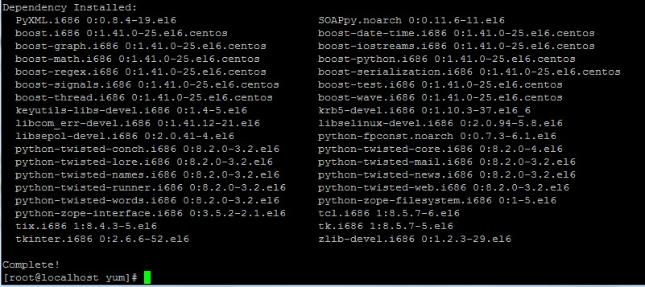
NOX – Installation [on CentOS 6.6]
Install dependencies
yum install gcc-c++ boost-devel openssl-devel automake autoconf swig git libtool libtool-dev python-devel python-twisted python-simplejson

Slide 9
NOX – Installation (cont.)
Get NOX packet
git clone git://github.com/noxrepo/nox
git clone git://noxrepo.org/nox

Slide 10
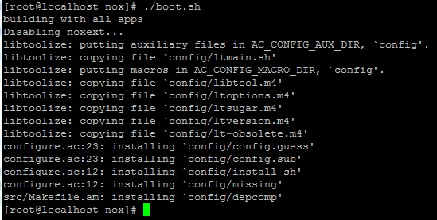
NOX – Installation (cont.)
Install NOX (1)
cd nox/
sudo ./boot.sh

Slide 11
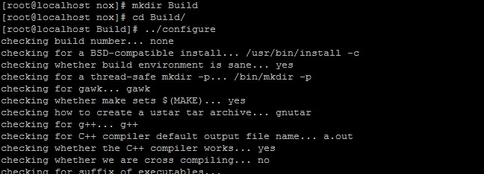
NOX – Installation (cont.)
Install NOX (2)
mkdir Build
cd Build/
../configure
make

Slide 12
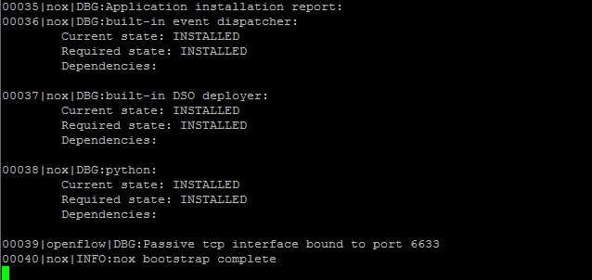
NOX - Implement
Run NOX
cd ~/nox/Build/src/
sudo ./nox_core –v –i ptcp:6633

Slide 13
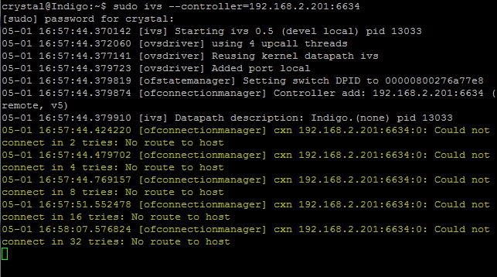
NOX – Connect to Indigo
Connection failed
Indigo is new, NOX is an old version

Slide 14
NOX - basic
listen to TCP PORT (default: 6633)
-i ptcp:[PORT]

Slide 15
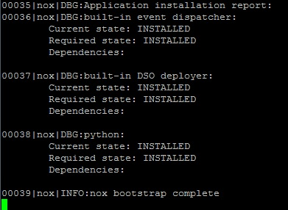
NOX – basic (cont.)
set maximum verbosity level (for console)
-v, --verbose

Slide 16
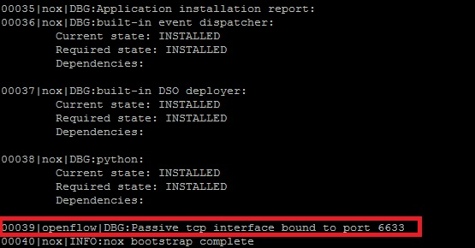
NOX – basic (cont.)
./nore_core -v -i ptcp:6633

Slide 17
NOX – basic (cont.)
display this help message
-h, --help
display version information
-V, --version

Slide 18
POX controller

Slide 19
POX – Installation [on Ubuntu 12.01]
Install dependencies
sudo apt-get install git
Get POX packet
git clone http://github.com/norepo/pox

Slide 20
POX - Implement
Run POX
cd pox/
./pox.py openflow.of_01 --address=192.168.2.228 --port=6633
192.168.2.228 must be change to your own IP address

Slide 21
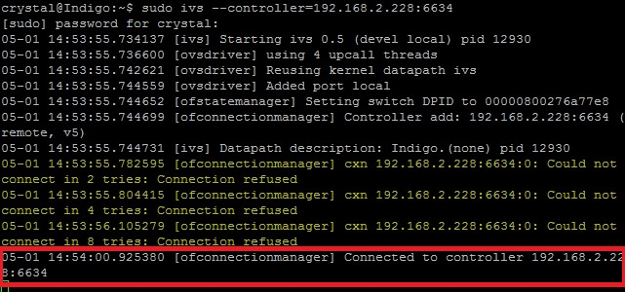
POX – Connect to Indigo
Connect successfully!
← POX
Indigo →

Slide 22
POX - basic
Print more debugging information (especially useful for problems on startup)
--verbose
Don't automatically load the OpenFlow module
--no-openflow
Load a Python log configuration file
--log-config=F

Slide 23
POX – basic (cont.)
Component
forwarding.l2_learning
makes OpenFlow switches act as a type of L2 learning switch
openflow.of_01
communicates with OpenFlow 1.0 switches.
Example:
./pox.py --verbose openflow.of_01 --address=192.168.2.228 --port=6634 forwarding.l2_learning

Slide 24
Reference
Introduce NOX & POX
http://www.noxrepo.org/
POX-full information
https://openflow.stanford.edu/display/ONL/POX+Wiki

