Slide 1
Ryu
Speaker : Angela

Slide 2
Outline
Developing history
Introduction
Installing Ryu
RYU Code Structure
Operations
Reference

Slide 3
What’s Ryu
龍
Oriental Dragion,
A god of water
流
Flow

Slide 4
Introduction
A component-based software-defined networking framework
License : Apache 2.0
Fully written in Python
Supports various protocols for managing network devices
OpenFlow, Netconf, OF-config, SNMP etc.

Slide 5
Installing Ryu
Platform
ryu 3.20.2
CentOS 7
Install some packages
yum install -y python-setuptools python-devel python-crypto python-simplejson autoconf python-pip python-devel gcc gcc-c++ libxml2-devel libxslt-devel
easy_install pip

Slide 6
Installing Ryu(Cont.)
Install Ryu
pip install ryu
yum install git
git clone git://github.com/osrg/ryu.git
Check status
ryu-manger
(以下為成功畫面) loading app ryu.controller.ofp_handler instantiating app ryu.controller.ofp_handler of OFPHandler

Slide 7
RYU Code Structure
app/ – Contains set of applications that run on-top of the controller.
base/ – Contains the base class for RYU applications. The RyuApp class in the app_manager.py file is inherited when creating a new application.
controller/ – Contains the required set of files to handle OpenFlow functions (e.g., packets from switches, generating flows, handling network events, gathering statistics etc).

Slide 8
RYU Code Structure(Cont.)
lib/ – Contains set of packet libraries to parse different protocol headers and a library for OFConfig. In addition, it includes parsers for Netflow and sFlow too.
ofproto/ – Contains the OpenFlow protocol specific information and related parsers to support different versions of OF protocol (1.0, 1.2, 1.3, 1.4)
topology/: Contains code that performs topology discovery related to OpenFlow switches and handles associated information (e.g., ports, links etc). Internally uses LLDP protocol.

Slide 9
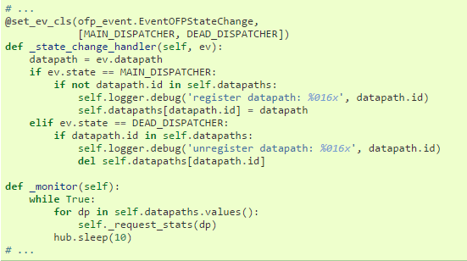
Traffic Monitor - Fixed-Cycle Processing

Slide 10
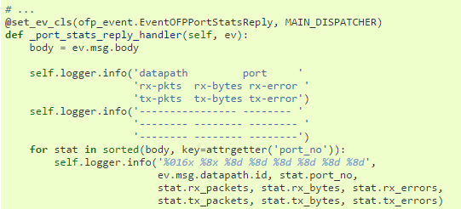
Traffic Monitor - PortStats

Slide 11
Executing Traffic Monitor
ryu-manager ./simple_monitor.py

Slide 12
Reference
http://www.slideshare.net/yamahata/ryu-sdnframeworkupload
RYU Controller Tutorial
Ryubook
Ryu SDN Framework

