Slide 1
RFC 3428
SIP Extension for Instant Messaging
B. Campbell, J. Rosenberg, H. Schulzrinne,
C. Huitema, D. Gurle
December 2002
劉冠伶 2023/05/19
Notes:
https://datatracker.ietf.org/doc/html/rfc3428

Slide 2
RFC 3428
Session Initiation Protocol (SIP) Extension for Instant Messaging
Instant Messaging (IM) refers to the delivery of messages between users in near real-time.
This document proposes the MESSAGE method, an extension to the Session Initiation Protocol (SIP) that allows the transfer of Instant Messages.
  The basic 6 methods of SIP are:
    REGISTER
    INVITE
    ACK
    BYE
    CANCEL
    OPTIONS

Slide 3
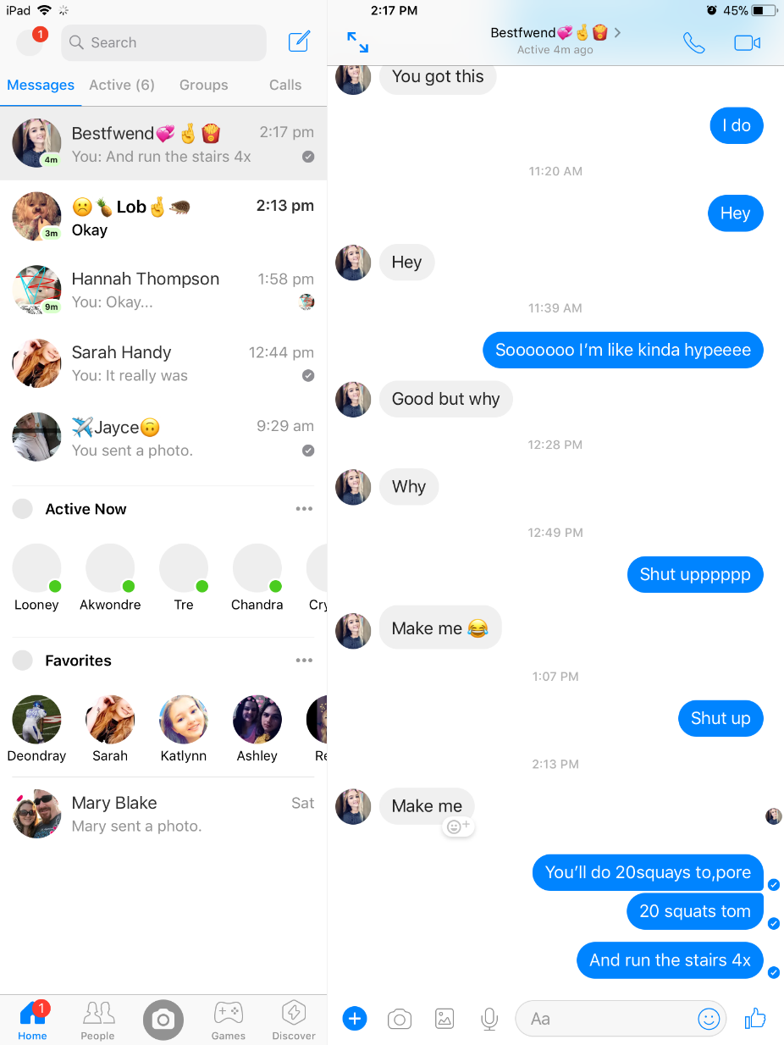

Instant Messaging
Instant Messaging (IM) is defined as the exchange of content between a set of participants in near real time.
has been used as a service coupled with presence and buddy lists; that is, when a friend comes online, a user can be made aware of this and have the option of sending the friend an instant message.

Slide 4
MESSAGE
An extension method for SIP
MESSAGE requests normally carry the instant message content in the request body
MESSAGE requests arguably carry media rather than signaling
IM applications are typically high volume. This will likely cause congestion problems if sent over a transport without congestion control.

Slide 5
Overview
When one user wishes to send an instant message to another, the sender formulates and issues a SIP request using the new MESSAGE method defined by this document.
The request may traverse a set of SIP proxies, using a variety of transports, before reaching its destination.
Provisional and final responses to the request will be returned to the sender as with any other SIP request.
MESSAGE requests do not establish dialogs
Notes:
A dialog is a peer-to-peer SIP relationship between two UAs that persists for some time. A dialog is established by SIP messages, such as a 2xx response to an INVITE request. When a session is initiated with an INVITE, each 1xx or 2xx response from a distinct UAS creates a dialog, and if that response completes the offer/answer exchange, it also creates a session. As a result, each session is "associated" with a single dialog - the one which resulted in its creation.

Slide 6
SIP Call Establishment [1/2]

Slide 7
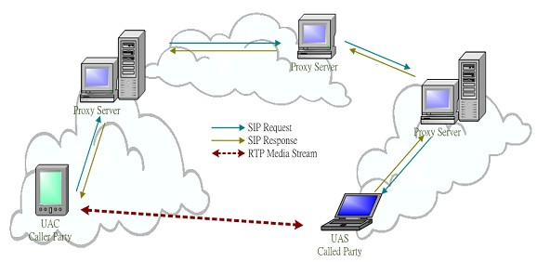
SIP Call Establishment [2/2]
Notes:
==============第一次進來================
這個圖是SIP元件的集大成…
左下和右下兩個就是所謂的網路電話, 中間有一大堆的server…
這個圖先大概看一下就好, 後面會有各種元件的詳細介紹
==============第二次進來================
Ok, 我們剛剛已經看過各種元件的功能了, 那我們回來再看一次這張圖
這邊有兩個UA, 然後中間這三台是Proxy, 左上角有個redirect server, 右上角是location server
我們可以看到 像redirect server和這台proxy (use pointer)以及這一台proxy (use pointer)都和location server結合在一起,
而這台proxy沒有redirect server, 所以他上面有一台redirect server給他查詢資料用…
要注意的是 這邊的SIP訊息畫的稍嫌簡略了, 事實上應該是要有 INVITE, 200 OK, 然後ACK…
假設左邊的UAC要打電話給UAS
所以一開始UAC送出邀請的訊息, 經過第一台proxy server, 可是他不知道UAS在哪裡, 所以就把訊息丟給redirect server
Redirect server可能不知道, 或者可能給一個UAS可能在的位置, 於是這台Proxy server就送到第二台proxy server
第二台proxy再去問問location server, location server也可能回給他不知道, 或是UAS可能在的位置
於是這個訊息再被送到第三台proxy server, 這台proxy知道UAS的位置 所以就可以把訊息送給UAS
UAS的回應訊息會沿著邀請的訊息倒著回去,
通話建立後, UAS和UAC在講話的資料就可以不用經由這些server了…

Slide 8
Boss<sip:Manager@pc1.home.com>
sip:Server.work.com
Daniel<sip:Collins@station1.work.com>
a
MESSAGE sip:Collins@work.com SIP/2.0
Via: SIP/2.0/UDP pc1.home.net; branch=z9hG4bK7890
Max-Forwards: 70
From: Boss<sip:Manager@home.net>
To: Daniel<sip:Collins@work.com>
Call-ID: 123456@pc1.home.net
CSeq: 1 MESSAGE
Content-Type: text/plain
Content-Length: 19
Content-Disposition: render
Hello. How are you?
b
MESSAGE sip:Collins@work.com SIP/2.0
Via: SIP/2.0/UDP server.work.com; branch=z9hG4bKxyz1
Via: SIP/2.0/UDP pc1.home.net; branch=z9hG4bK7890
Max-Forwards: 69
From: Boss<sip:Manager@home.net>
To: Daniel<sip:Collins@work.com>
Call-ID: 123456@pc1.home.net
CSeq: 1 MESSAGE
Content-Type: text/plain
Content-Length: 19
Content-Disposition: render
Hello. How are you?
c
d
SIP/2.0 200 OK
Via: SIP/2.0/UDP server.work.com; branch=z9hG4bKxyz1
Via: SIP/2.0/UDP pc1.home.net; branch=z9hG4bK7890
From: Boss<sip:Manager@home.net>
To: Daniel<sip:Collins@work.com>
Call-ID: 123456@pc1.home.net
CSeq: 1 MESSAGE
Content-Length: 0
SIP/2.0 200 OK
Via: SIP/2.0/UDP pc1.home.net; branch=z9hG4bK7890
From: Boss<sip:Manager@home.net>
To: Daniel<sip:Collins@work.com>
Call-ID: 123456@pc1.home.net
CSeq: 1 MESSAGE
Content-Length: 0

Slide 9
Boss<sip:Manager@pc1.home.com>
sip:Server.work.com
Daniel<sip:Collins@station1.work.com>
e
MESSAGE sip:Manager@home.net SIP/2.0
Via: SIP/2.0/UDP station1.work.com; branch=z9hG4bK123
Max-Forwards: 70
From: Daniel<sip:Collins@work.com>
To: Boss<sip:Manager@home.net>
Call-ID: 456789@station1.work.com
CSeq: 1101 MESSAGE
Content-Type: text/plain
Content-Length: 22
Content-Disposition: render
I’m fine. How are you?
f
MESSAGE sip:Manager@home.net SIP/2.0
Via: SIP/2.0/UDP server.work.com; branch=z9hG4bKabcd
Via: SIP/2.0/UDP station1.work.com; branch=z9hG4bK123
Max-Forwards: 69
From: Daniel<sip:Collins@work.com>
To: Boss<sip:Manager@home.net>
Call-ID: 456789@station1.work.com
CSeq: 1101 MESSAGE
Content-Type: text/plain
Content-Length: 22
Content-Disposition: render
I’m fine. How are you?
g
SIP/2.0 200 OK
Via: SIP/2.0/UDP server.work.com; branch=z9hG4bKabcd
Via: SIP/2.0/UDP station1.work.com; branch=z9hG4bK123
From: Daniel<sip:Collins@work.com>
To: Boss<sip:Manager@home.net>
Call-ID: 456789@station1.work.com
CSeq: 1101 MESSAGE
Content-Length: 0
h
SIP/2.0 200 OK
Via: SIP/2.0/UDP station1.work.com; branch=z9hG4bK123
From: Daniel<sip:Collins@work.com>
To: Boss<sip:Manager@home.net>
Call-ID: 456789@station1.work.com
CSeq: 1101 MESSAGE
Content-Length: 0

Slide 10
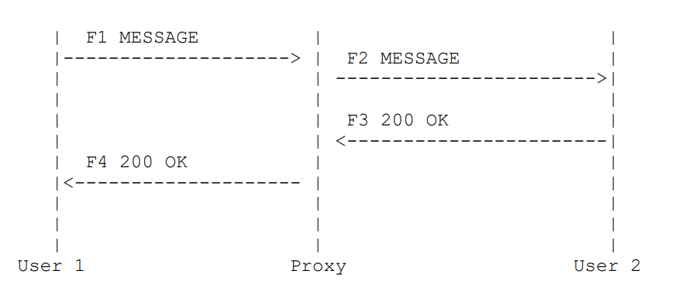
Example

Slide 11

Example (Cont.)
F1 MESSAGE User1 -> Proxy
MESSAGE sip:user2@domain.com SIP/2.0
Via: SIP/2.0/TCP user1pc.domain.com;branch=z9hG4bK776sgdkse
Max-Forwards: 70
From: sip:user1@domain.com;tag=49583
To: sip:user2@domain.com
Call-ID: asd88asd77a@1.2.3.4
CSeq: 1 MESSAGE
Content-Type: text/plain
Content-Length: 18
Watson, come here.
MUST NOT insert Contact header fields
carry the instant message content in the request body

Slide 12
Example (Cont.)
F2 MESSAGE Proxy -> User2
MESSAGE sip:user2@domain.com SIP/2.0
Via: SIP/2.0/TCP proxy.domain.com;branch=z9hG4bK123dsghds
Via: SIP/2.0/TCP user1pc.domain.com;branch=z9hG4bK776sgdkse;received=1.2.3.4
Max-Forwards: 69
From: sip:user1@domain.com;tag=49583
To: sip:user2@domain.com
Call-ID: asd88asd77a@1.2.3.4
CSeq: 1 MESSAGE
Content-Type: text/plain
Content-Length: 18
Watson, come here.

Slide 13
Example (Cont.)
F3 200 OK User2 -> Proxy
SIP/2.0 200 OK
Via: SIP/2.0/TCP proxy.domain.com;branch=z9hG4bK123dsghds;received=192.0.2.1
Via: SIP/2.0/TCP user1pc.domain.com;;branch=z9hG4bK776sgdkse; received=1.2.3.4
From: sip:user1@domain.com;tag=49583
To: sip:user2@domain.com;tag=ab8asdasd9
Call-ID: asd88asd77a@1.2.3.4
CSeq: 1 MESSAGE
Content-Length: 0
MUST NOT contain a body

Slide 14
Example (Cont.)
F4 200 OK Proxy -> User1
SIP/2.0 200 OK
Via: SIP/2.0/TCP user1pc.domain.com;branch=z9hG4bK776sgdkse;received=1.2.3.4
From: sip:user1@domain.com;;tag=49583
To: sip:user2@domain.com;tag=ab8asdasd9
Call-ID: asd88asd77a@1.2.3.4
CSeq: 1 MESSAGE
Content-Length: 0

Slide 15
RFC 3994
Indication of Message Composition for Instant Messaging
H. Schulzrinne
Columbia University
January 2005

Slide 16
Motivation
By definition, instant messaging (IM) is message based: A user composes a message by, for example, typing, speaking, or recording a video clip.
  This message is then sent to one or more recipients.
Unlike email, instant messaging is often conversational, so the other party is waiting for a response.
If no response is forthcoming, a participant in an instant messaging conversation may erroneously assume
  either that the communication partner has left or that
  it is her turn to type again, leading to two messages "crossing on the wire".

Slide 17
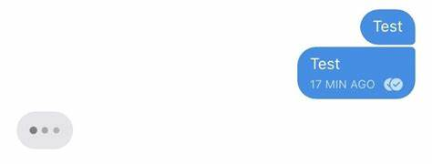
Indication of Message Composition
To avoid the aforementioned uncertainty, a number of commercial instant messaging systems feature an "is-typing" indication sent as soon as one party starts typing a message.
RFC 3994 defines the isComposing status message.
This status message is delivered to the instant message recipient in the same manner as are the messages themselves.
The status messages are carried as XML, and labeled as an application/im-iscomposing+xml content type.

Slide 18
Figure 1. Sender State Diagram
+-------------+
|+-----------+|
|| ||
+------>| idle |<--------+
| || || |
| |+-----------+| |
| +------+------+ |
content | | | idle timeout
msg. sent | | composing | w/o activity
----------- | | ------------- | ------------------
-- | | "active" msg. | "idle" status msg.
| | |
| +------V------+ |
| | | |
| | | |
| | | |
+------+ active +--------+
| |
| |------+
+------^------+ | refresh timeout
| | --------------------
| | "active" status msg.
+-------------+
Condition
Output

Slide 19
Figure 2. Receiver State Diagram
+-------------+
|+-----------+|
|| ||
+------>| idle |<------+
| || || |
| |+-----------+| |
| +------+------+ |
| | |
"idle" recd. | |"active" msg.| refresh timeout
or content recd. | | | or 120s
| | |
| +------V------+ |
| | | |
| | | |
| | | |
+------+ active +------+
| |
| |
+-------------+
Default value if the refresh interval is omitted in the previous “active” status msg.

Slide 20
Examples
<?xml version="1.0" encoding="UTF-8"?>
<isComposing xmlns="urn:ietf:params:xml:ns:im-iscomposing"
xmlns:xsi="http://www.w3.org/2001/XMLSchema-instance"
xsi:schemaLocation="urn:ietf:params:xml:ns:im-composing
iscomposing.xsd">
<state>active</state>
<contenttype>text/plain</contenttype>
<refresh>90</refresh>
</isComposing>
<?xml version="1.0" encoding="UTF-8"?>
<isComposing xmlns="urn:ietf:params:xml:ns:im-iscomposing"
xmlns:xsi="http://www.w3.org/2001/XMLSchema-instance"
xsi:schemaLocation="urn:ietf:params:xml:ns:im-composing
iscomposing.xsd">
<state>idle</state>
<lastactive>2003-01-27T10:43:00Z</lastactive>
<contenttype>audio</contenttype>
</isComposing>

Slide 21
[Lab] Instant Messaging
http://course.ipv6.club.tw/VoIP/1113/rfc3428-im.html
No class on 7/10 (Mon)
  Code tracing on 7/12 (Wed)

